Slide 1
Multimodal Meta-Learning for Cold-Start Sequential Recommendation
method
task
Source : CIKM ‘22
Speaker : yang-YI, LIN
Advisor : Jia-Ling, Koh
Date : 2023/09/19

Slide 2
Outline
Introduction
Method
Experiment
Conclusion

Slide 3
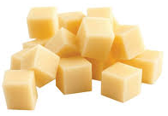
Task – Cold-Start Sequential Recommendation
sequential recommendation
cold-start sequential recommendation
new
or
cold-start user
cold-start item

Slide 4
Task – Cold-Start Sequential Recommendation
：meta-learning
：incorporates multimodal side information
new

Slide 5
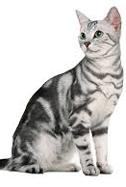
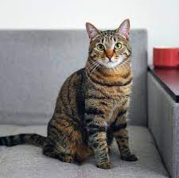
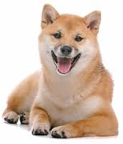
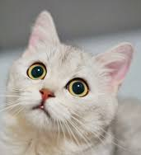
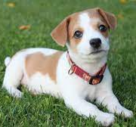
Meta-Learning
machine learning
train
valid
test
cat
dog
cat
valid
cat
dog
dog
……
cat

Slide 6
Meta-Learning
meta-learning
train
……
cat

Slide 7
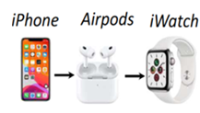
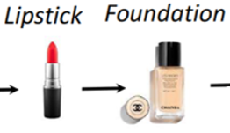
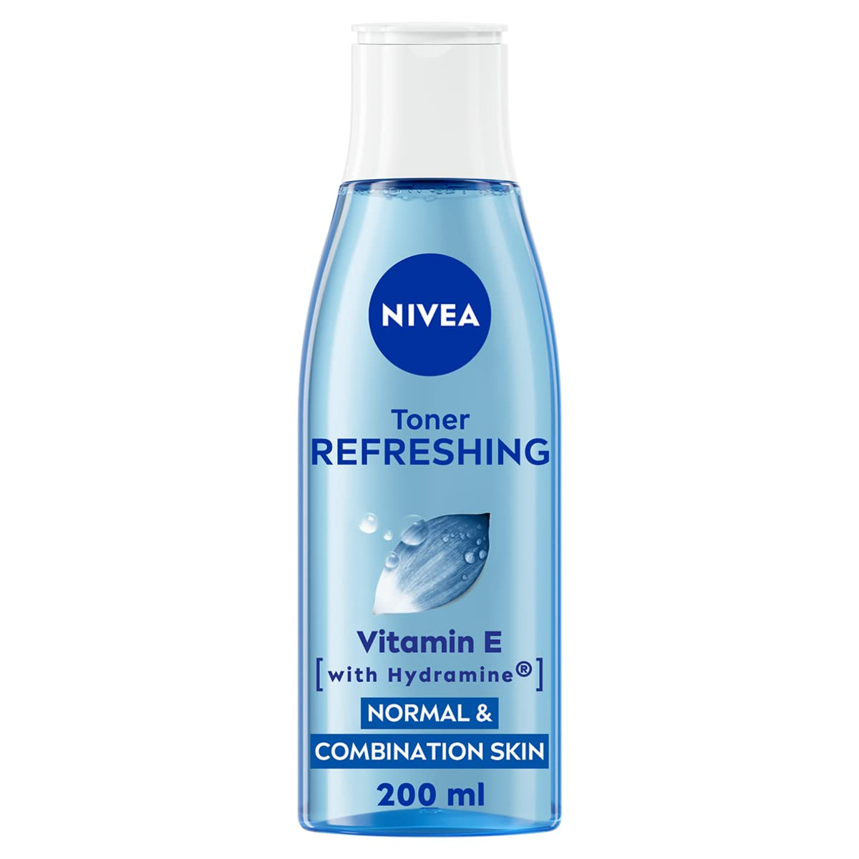
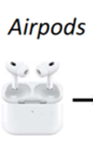
Task – Cold-Start User
meta-learning
train
User 1
iPad
pencil
User 2
toner
……

Slide 8
Task – Cold-Start Item
：incorporates multimodal side information
new
title
Item ID
image
encoder
Item embedding

Slide 9
Outline
Introduction
Method
Experiment
Conclusion

Slide 10
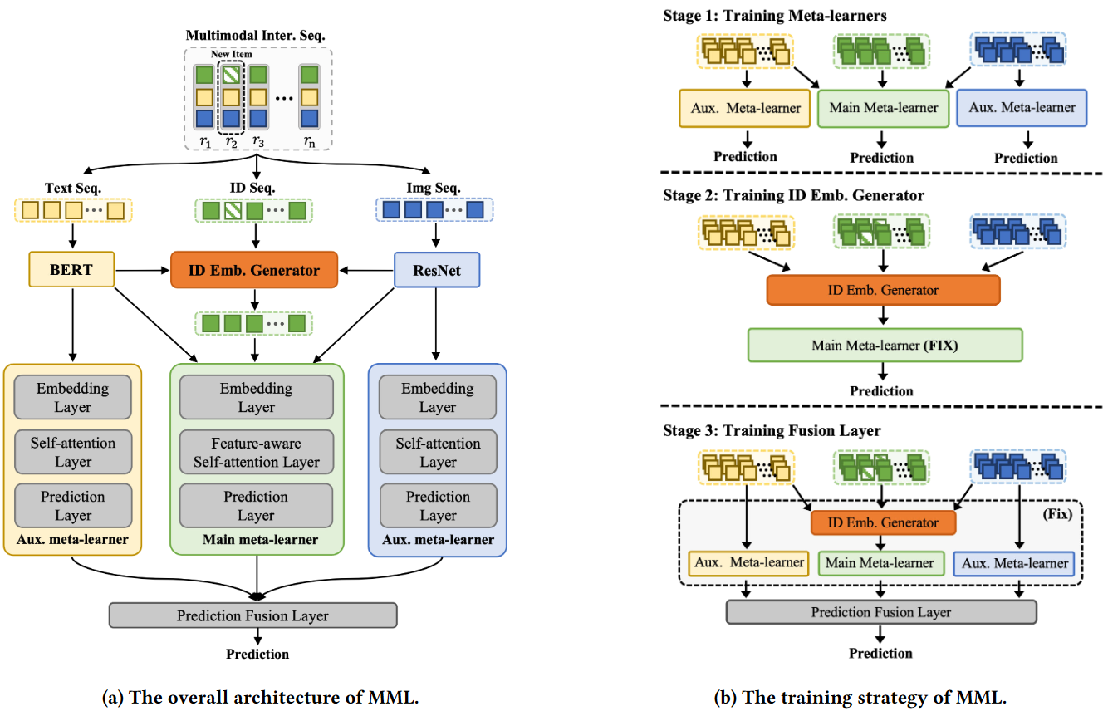
Method — Multimodal Meta-Learning (MML)

Slide 11
Problem Formulation
predict the next item ID of new user
data：interaction record 𝑟 $= ⟨u, i^{id}, i^{te}, i^{im}⟩$
user 𝑢 interaction sequence $S_{u} = \{r_{1}, · · · , r_{n} \}$
$$D_{old}$$
before timestamp after
𝑇
$$D_{new}$$
Text seq.
Text seq.
ID seq.
ID seq.
Img Seq.
Img Seq.

Slide 12
Embedding Layers
𝑛-length item sequence
$$E_{te} ∈ R^{nxd}$$
$$E_{id} ∈ R^{nxd}$$
$$E_{im} ∈ R^{nxd}$$

Slide 13
Feature-Aware Self-Attention Block
multi-head self-attention + text & image bias
self-attention layer：
$$l$$
$$l$$
$$l$$
$$l$$

Slide 14
Feature-Aware Self-Attention Block
multi-head self-attention + text & image bias
multi-head self-attention layer：

Slide 15
Feature-Aware Self-Attention Block

Slide 16
Prediction Layer
output：user’s preference score $P$
concat $P$ of 𝑐 candidate items

Slide 17
Multimodal Prediction Fusion
concat and layer normalization
attention function：use a single-layer feed-forward neural network
prediction scores $p$

Slide 18
Cold-start Item Embedding Generator
select the top 𝐾 most similar old items
new item 𝑧 , old items $o$
calculate the attention weight for each old item 𝑜
generate the item ID embedding

Slide 19
Outline
Introduction
Method
Experiment
Conclusion

Slide 20
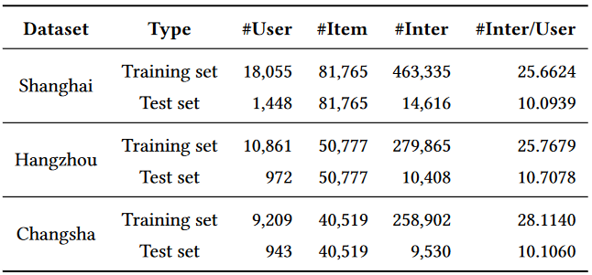
Data Set
click logs covering meals, hotel, tourism and other 6 businesses in Meituan App from June to October 2021
the interactions before September 10, 2021 is $D_{old}$ ,
other users as new users, and the interactions of these users is $D_{new}$
Training set：
Test set：

Slide 21
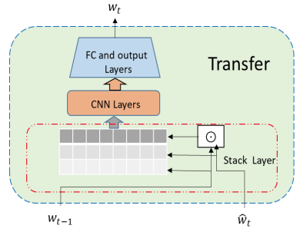
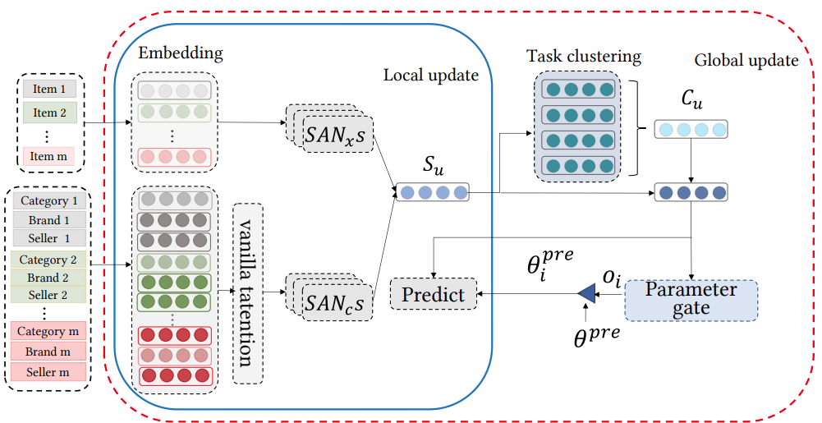
Experiment
SML
CBML
SASRec： self-attention
GRU4Rec：RNN
Full：Matrix Factorization
PT-FT：Pre-train and Fine-tune

Slide 22
Ablation Study
NO-Gen: randomly generated embeddings for new items
NO-Fusion: average fusion for three meta-learners
${MML}_{ID}：$no multimodal side information(text、image)

Slide 23
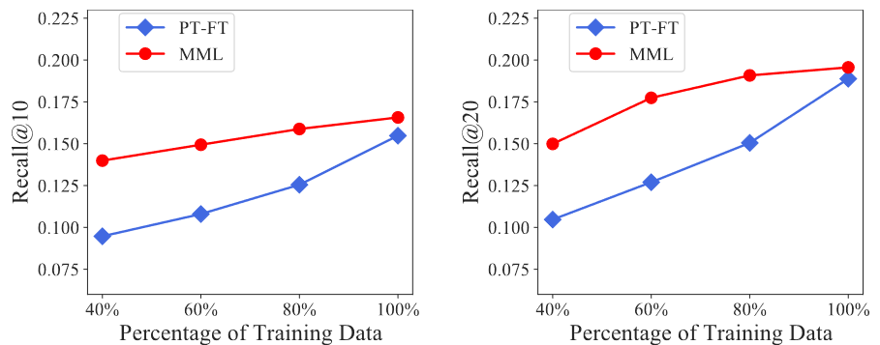
Influence Analysis of Training Data

Slide 24
Conclusion
the Multimodal Meta-Learning (MML) approach by leveraging multimodal side information of items for cold-start sequential recommendation
a cold-start item embedding generator to warm up ID embeddings of new items
modality-specific meta-learner to capture the sequential characteristics from different perspectives

